Slide 1
CORE
COUNCIL OFFICE OF RACIAL EQUITY
- NEW COUNCILMEMBER - - ORIENTATION–
-NOVEMBER 30, 2022-
All artwork painted by Eric B. Ricks as part of DPW’s MuralsDC program.
Notes:
Good morning!
I’m Danaya Hough, CORE’s Community Engagement Champion. We’ll get more into introductions here, shortly. First, I want to thank all of you for being here and huge thank you to Professor Jasmine for organizing all of this and thinking of CORE to present to your students!
Today, we’ll be giving you all an overview presentation of CORE and talking through our REIA writing process. And we’re looking forward to hearing from all of you about your research projects!
I think the best way to introduce you all to our office and our work is through this custom spoken word piece that was written by a poet from DC, Luki, and features music from Grammy award-winning artists, Brasstracks.

Slide 2
NAMITA (NAMI) MODY DIRECTOR
Committee of the Whole MILIKA ROBBINS SENIOR POLICY + DATA ANALYST
Transportation and the Environment Business and Economic Development
Health
ROLANDO CUEVAS RACIAL EQUITY ANALYST
Housing and Executive Administration Government Operations and Facilities
DANAYA HOUGH COMMUNITY ENGAGEMENT CHAMPION
Recreation, Libraries, and Youth Affairs
JARRED BOWMAN RACIAL EQUITY ANALYST
Committee of the Whole (Education)
Human Services
SARINA PHU RACIAL EQUITY ANALYST
Judiciary and Public Safety Labor and Workforce Development
Meet the Team
Follow @dcracialequity on Instagram and Twitter! Email us CORE@dccouncil.gov
Notes:
I hope you all enjoyed that as much as we do! We had a really great time working with Luki and we’re so grateful to Brasstracks for allowing us to use their music. The piece really captures who we are as an office and the quality of work we are always striving to complete.
Now I’m going to take a moment to introduce the CORE team. And after, we’re all going to share a little about our journey to our current roles.

Slide 3
What does CORE do?
We write Racial Equity Impact Assessments (REIAs) for permanent Council legislation​.
We hold CORE Conversations and trainings for Councilmembers and staff. ​
We conduct research and create resources for Councilmembers, Council staff, and District residents.
Notes:
A brief background on our office:
The Council Office of Racial Equity was established by a piece of legislation called the REACH Act-or the Racial Equity Achieves Act.
Our office officially launched on MLK Day of 2021. And in that time our work has fallen into three main buckets. We’ve conducted racial equity trainings for council members and staff, given a number of presentations like this one, conducted research and created resources such as our report on the Racial Wealth Gap in the District of Columbia that we conducted with MITRE and the COVID-19 report that discussed a racially equitable vaccine distribution process.
Since we’ve launched, one other thing that we’ve done that’s really taken up the bulk of our time and effort, is writing Racial Equity Impact Assessments (REIAs). To date, we’ve written around 60 REIAs, and by the end of the week, we’ll have added another ten or so to that list.

Slide 4
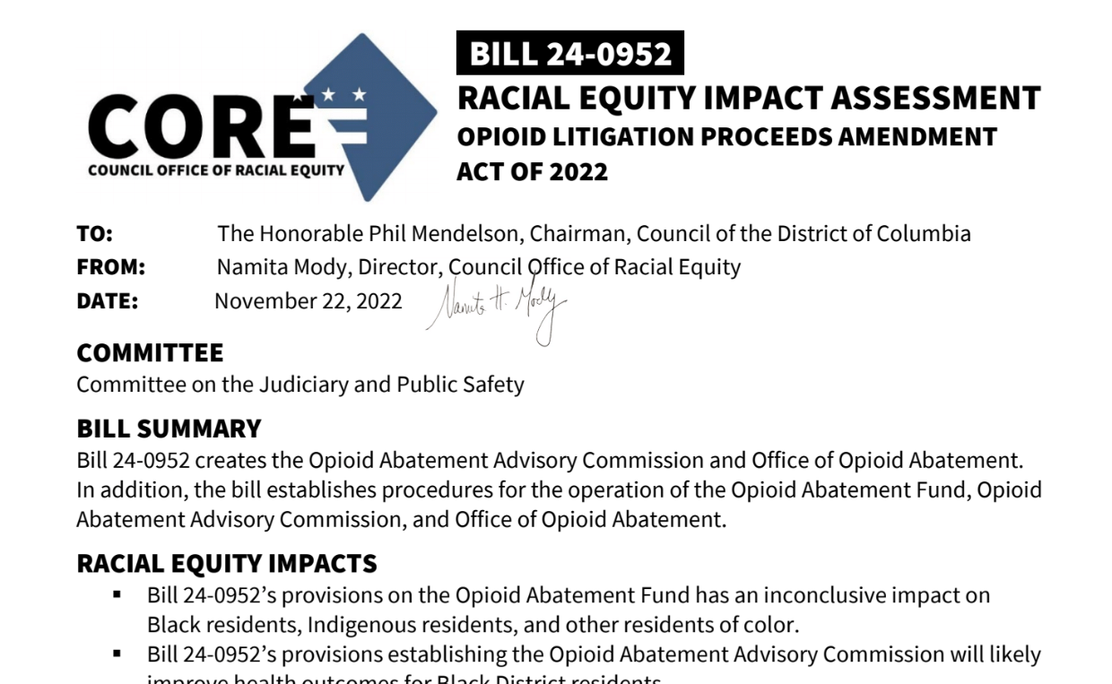
What is a REIA?
A REIA is a careful and organized examination of how a proposed bill will affect racial and ethnic groups. A REIA helps Councilmembers, staff, and the community make decisions about bills with a thorough understanding of how a bill will affect the lives of Black residents, Indigenous residents, and other residents of color.
Notes:
Before we dive into explaining what a REIA is, by a show of hands, who all knows what racial equity is? Can someone explain it for us?
Racial equity is the elimination of racial disparities. The idea is: When we achieve racial equity, race will no longer predict opportunities, outcomes, or the distribution of resources for District residents—particularly for Black, Indigenous, and residents of color.
Our REIAs are all organized in the same manner, with minor tweaks based on the bill. But each REIA contains six primary sections. I’m not going to name them off, because if I do, I’ll likely do so in order which will give you a hint for the question I’m about to ask.

Slide 5
EXPERIENCES OF EACH RACIAL + ETHNIC POPULATION
LEGACIES OF HISTORIC
RACIAL TRAUMA
WHO ENGAGED AND WHAT THEY SHARED
A REIA COVERS
THE RESIDENT EXPERIENCE
RELEVANT RESEARCH
POTENTIAL FOR DISPARATE
RACIAL AND
ETHNIC OUTCOMES
Notes:
Legacies of Historic Racial Trauma
Why do different racial and ethnic groups fare differently when we examine the issues related to the bill?
What events, decisions, and policies have led to the inequities we see today?
Who Engaged and What They Shared
Who was engaged when decisions were made?
Who was engaged but did not have institutionally or socially recognized power to influence decisions?
What have residents been saying about this issue generally and at the bill’s public hearing?
The Resident Experience
What will it look and feel like for a resident to interact with this bill from start to finish?
In what ways are the processes inclusionary, in what ways are they exclusionary, and to whom?
How are these processes being monitored for bias?
Relevant Research
What is the goal of this policy?
What do we know about how this goal has been addressed before, both in DC and elsewhere?
What research can we find about this program, intervention, or policy and is it strong (internally valid)?
Potential for Disparate Racial and Ethnic Outcomes
How will different racial and ethnic groups be impacted?
Will disparate racial outcomes be monitored and addressed?

Slide 6
Our assessments are public.

Slide 7
ANSWERING QUESTIONS ABOUT REIAs
TRAININGS THROUGH A RACIAL EQUITY LENS
SOUNDBOARDING ON RACIAL EQUITY IN PROCESSES
OUR SUPPORT
NON-REIA RESEARCH REPORTS
NO QUESTION TOO BIG OR TOO SMALL!
Notes:
Legacies of Historic Racial Trauma
Why do different racial and ethnic groups fare differently when we examine the issues related to the bill?
What events, decisions, and policies have led to the inequities we see today?
Who Engaged and What They Shared
Who was engaged when decisions were made?
Who was engaged but did not have institutionally or socially recognized power to influence decisions?
What have residents been saying about this issue generally and at the bill’s public hearing?
The Resident Experience
What will it look and feel like for a resident to interact with this bill from start to finish?
In what ways are the processes inclusionary, in what ways are they exclusionary, and to whom?
How are these processes being monitored for bias?
Relevant Research
What is the goal of this policy?
What do we know about how this goal has been addressed before, both in DC and elsewhere?
What research can we find about this program, intervention, or policy and is it strong (internally valid)?
Potential for Disparate Racial and Ethnic Outcomes
How will different racial and ethnic groups be impacted?
Will disparate racial outcomes be monitored and addressed?

Slide 8
CORE
QUESTIONS?
COUNCIL OFFICE OF RACIAL EQUITY
TRAINING INSTITUTE
All artwork painted by Eric B. Ricks as part of DPW’s MuralsDC program.

